Slide 1
EXCLUDE Level of Detail
John F. Tripp

Slide 2
Exploring Calculations in Tableau
Level of Detail Expressions
  FIXED
  INCLUDE
  EXCLUDE

Slide 3
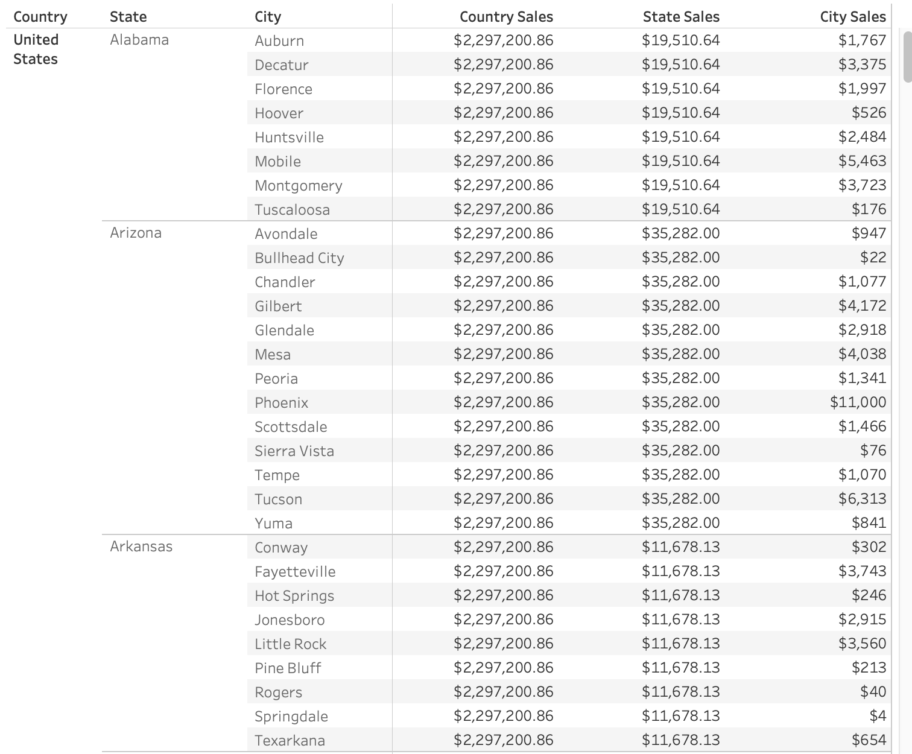
Exclude
What if we wanted to create something that looks like this?
Three different levels of detail for aggregation, side by side.
You can’t with drag and drop – you can using Exclude LOD

Slide 4
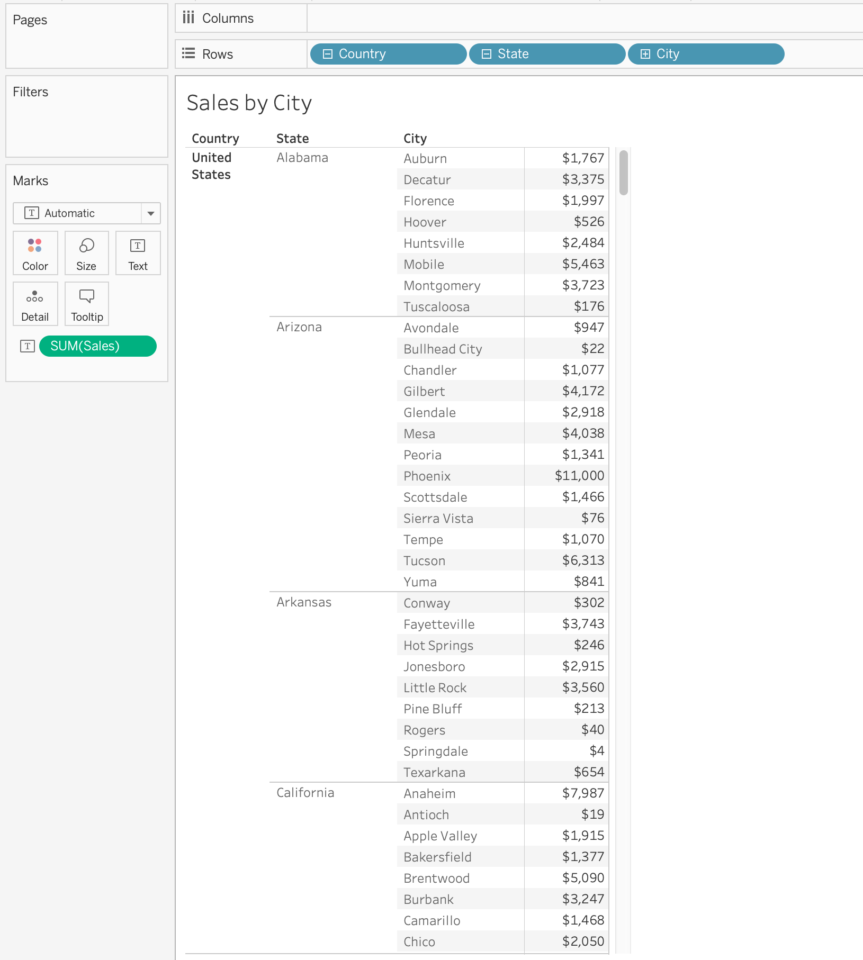
Exclude
Load the Superstore sample data, and make this:

Slide 5
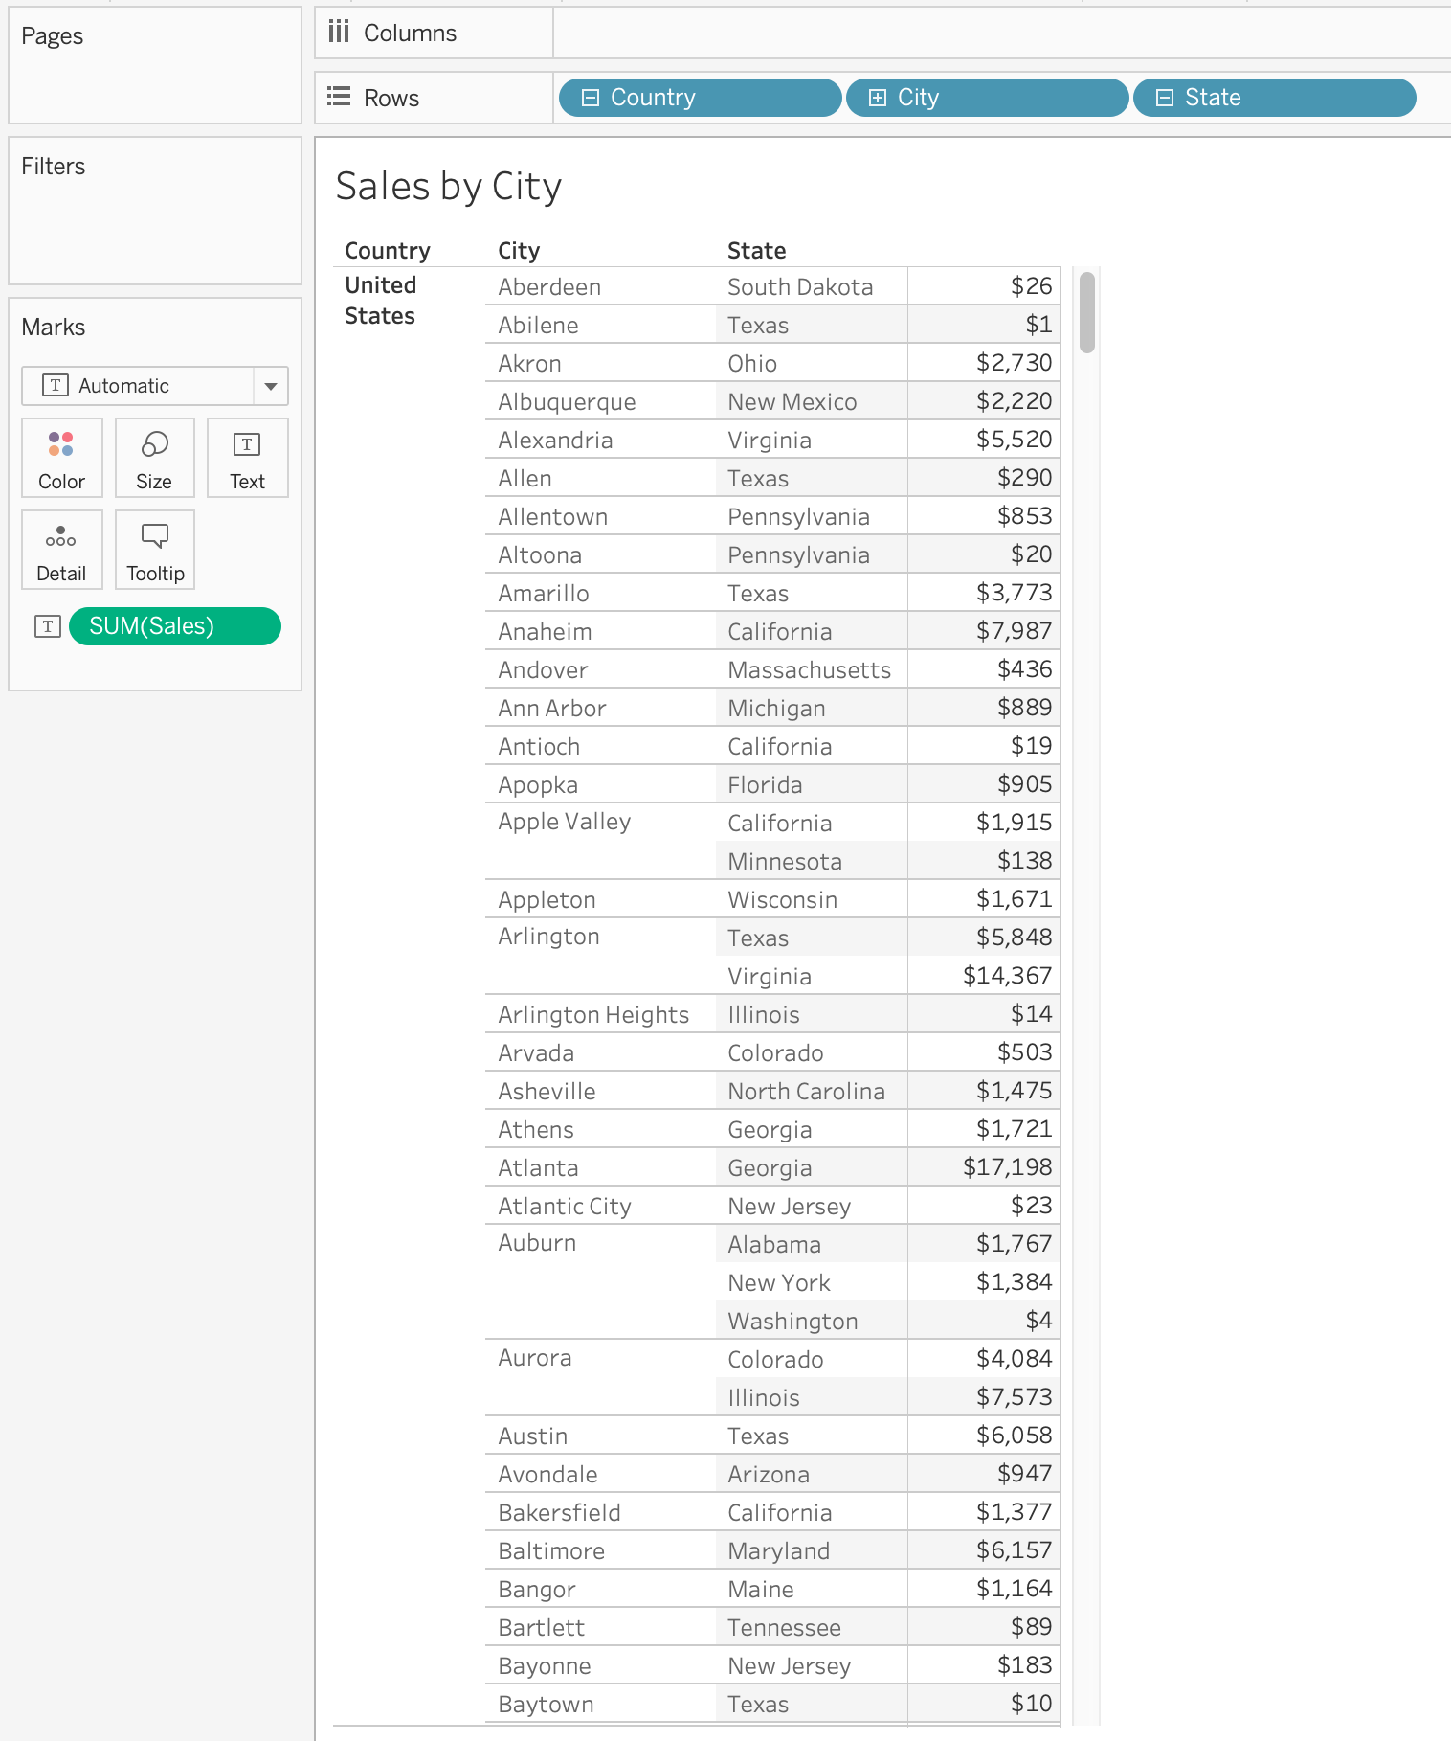
Exclude
If we rearrange the dimensions we get same numbers, just the dimensions are in a different order

Slide 6
Exclude
Syntax:
  {EXCLUDE [dim1], [dim2],…,[dimN] : aggregate expression }
Create a new field called LOD Sales Exclude City, and add this calculation:
  {EXCLUDE [City] : Sum([Sales])}
  (By using this calculation, we are removing City from our view for the purpose of our LOD calculation to determine a value based on the State’s level of detail.)

Slide 7
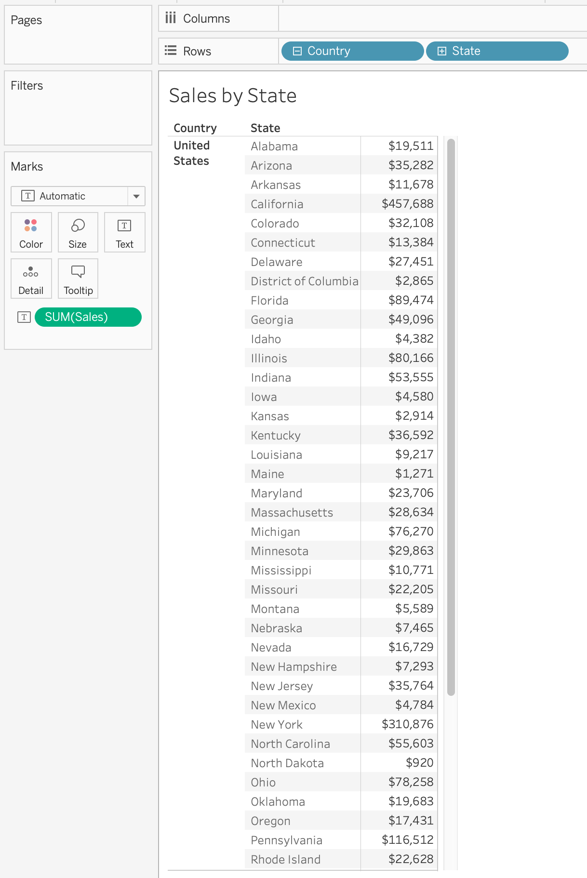
Exclude
In essence, the Exclude command is mimicking this view:

Slide 8
Summary of Exclude and Include
The EXCLUDE and INCLUDE LODs are executed after data blending, and before measure filters are applied.
  These LODs are dependent upon the visualization in which they are applied.
    If you EXCLUDE a dimension that isn’t in the view, nothing will happen.
    If you INCLUDE a dimension into the wrong view, you’re going to get strange results.

Slide 9
FIXED
Syntax:
  {FIXED[dim1], [dim2],…,[dimN] : aggregate expression }
Create a new field called FIXED LOD Sales, and add this calculation:
  {FIXED : Sum([Sales])}
  (By using this calculation, we are calculating the sum of sales for all the data that has passed the extract, data source, and context filters – REGARDLESS of additional filtering by dimensions or measures)

